Slide 1

Presentation on Smart Water Management For Village
Name of Subject : Internet of things(IOT)
Presented by :
Aditi Kadam (2124UMLF2003)
Tanmay Gawali (2124UMLM2016)
Guided by:
Dr. kiran wakchaure
Department of Artificial Intelligence & Machine Learning
School of Engineering & Technology
Sanjivani University
Semester-IV, Academic Year 2024-2025

Slide 2
INTRODUCTION
Smart Water Management System for Villages automates drinking water distribution to reduce wastage, improve efficiency, ensure water quality. Sensors monitor tank levels & water quality, automating motor control to prevent overflow. Solenoid valves enable scheduled distribution. A user-friendly App enables admin to remotely manage water flow. If water quality is poor, it is redirected for non-drinking purposes like farming. This system eliminates manual effort, enhances reliability, ensures a clean and efficient water supply for rural areas.

Slide 3
PROBLEM STATEMENT
In many villages, drinking water management is entirely manual, leading to inefficiencies, wastage, and health risks. The tank filling process lacks automation, causing overflows and delays. Water quality is not monitored, increasing contamination risks. Water distribution is irregular, and villagers are not notified in advance. Dependence on a single admin further disrupts the process, making water access unreliable and unsustainable.

Slide 4
EXISTING SYSTEM
Currently, village water distribution relies on manual processes, leading to inefficiencies and inconsistencies:
Tank Filling: The admin manually operates motor, often causing overflow or shortages due to lack of real-time monitoring.
Water Quality: No monitoring system exists, increasing risk of contaminated water being supplied.
Water Distribution: Admin manually opens and closes taps on a fixed schedule, which isn’t always followed, leading to delays and unfair distribution.
Lack of Notifications: Villagers aren't informed about water availability, causing uncertainty.
Single Point of Dependence: If admin is unavailable, entire system is disrupted, making water supply unreliable.

Slide 5
PROPOSED SYSTEM
Our proposed solution automates village water distribution, improving efficiency:
Tank Filling: Water level sensor detects levels; motor fills tank, preventing overflow. Monthly cleaning alert sent to admin.
Water Quality: Turbidity, pH sensors monitor quality; poor-quality water is redirected for non-drinking use.
Water Distribution: Filters enhance quality; solenoid valves automate tap control.
Dashboard: Admin monitors tank levels, water quality, distribution status via website.

Slide 6
TECHNOLOGY USED
Software Components:
Database: Firebase
Application: MIT App Inventor
Microcontroller Programming: C++
Hardware Components:
Microcontroller: ESP32
Conductive Water Level Sensor
Water Quality Sensors: Turbidity sensor
Valves: Solenoid valves
Motor: Water pump
Communication Module: Wi-Fi module

Slide 7
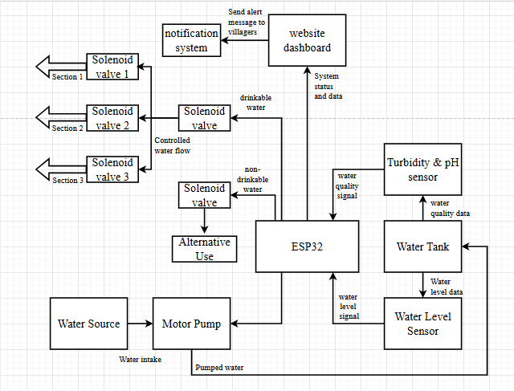
BLOCK DIAGRAM

Slide 8
BENEFITS
Automatically refills the water tank when the level gets low. This reduces manual effort and ensures a constant water supply without interruptions.
Prevents water overflow by cutting off the flow at full level. It helps conserve water and protects your space from water damage and flooding.
Allows remote monitoring and control through Firebase. You can check water levels and control the system from anywhere using your phone or computer.
Easily expandable to support additional valves or sensors. The system can be scaled for larger setups or customized needs without major changes.

Slide 9
CONCLUSION
The Smart Water Management System addresses the need for efficient and reliable water distribution in villages through automation and real-time monitoring. It reduces wastage, improves water quality, and ensures fair access to clean water. The system is feasible with readily available components and commercially viable for rural and urban areas. Its unique combination of automation and monitoring enhances efficiency, making it scalable for industrial use and suitable for patenting and wider implementation.

Slide 10
THANK YOU

